Slide 1
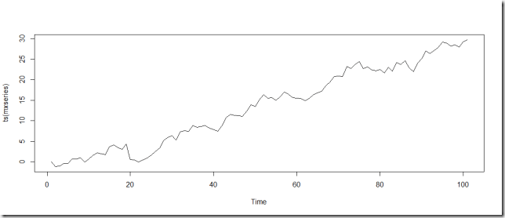
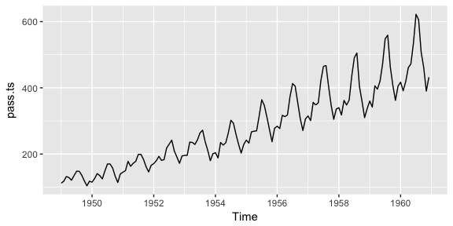

WHY NOT ARIMA OR SARIMA
ARIMA:
For respective ARIMA(p,d,q), the ARIMA equations is as follows:
SARIMA:
For respective SARIMA(p,d,q)(P,D,Q)m, the SARIMA equation is as follows:

Slide 2
RNN FOR TIME SERIES FORECASTING
RNN with LSTM is very good for data points with Non-Linear relationship.
They are parametric in nature.
The benefit of using RNN is that we have more number of hyper parameter as compared to ARIMA and hence we can tune anyone of them to get the optimal solution.

Slide 3
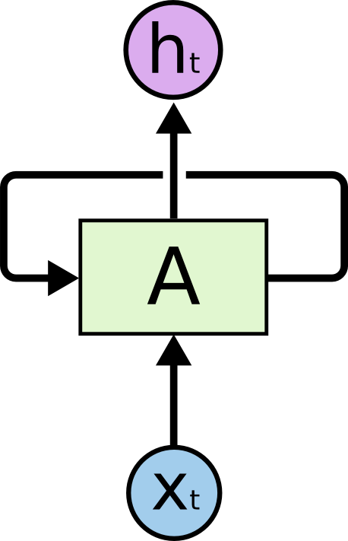
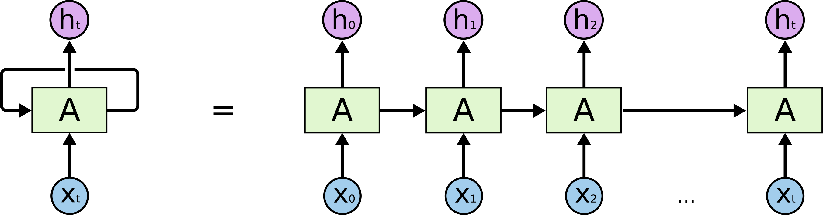
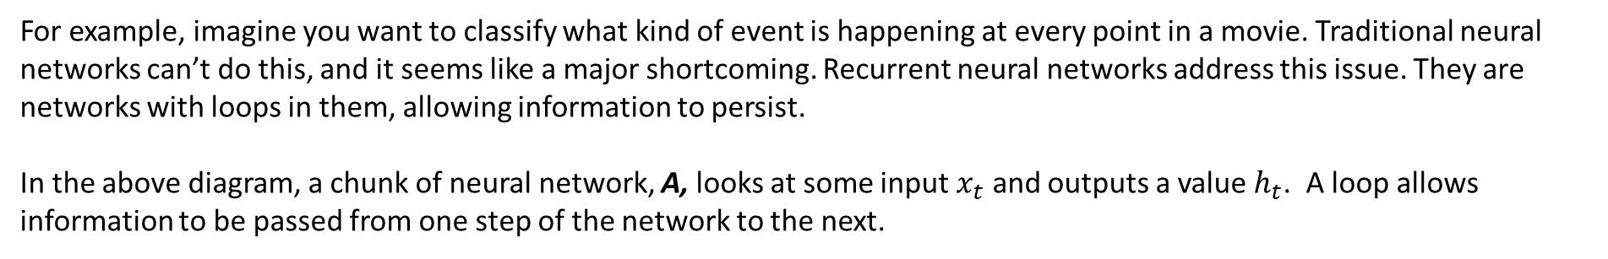
RNN with LSTM
Figure - Recurrent Neural Networks have loops.
Figure - An unrolled recurrent neural network.
For example, imagine you want to classify what kind of event is happening at every point in a movie. Traditional neural networks can’t do this, and it seems like a major shortcoming. Recurrent neural networks address this issue. They are networks with loops in them, allowing information to persist.
In the above diagram, a chunk of neural network, A, looks at some input $x_{t}$ and outputs a value $h_{t}$. A loop allows information to be passed from one step of the network to the next.

Slide 4
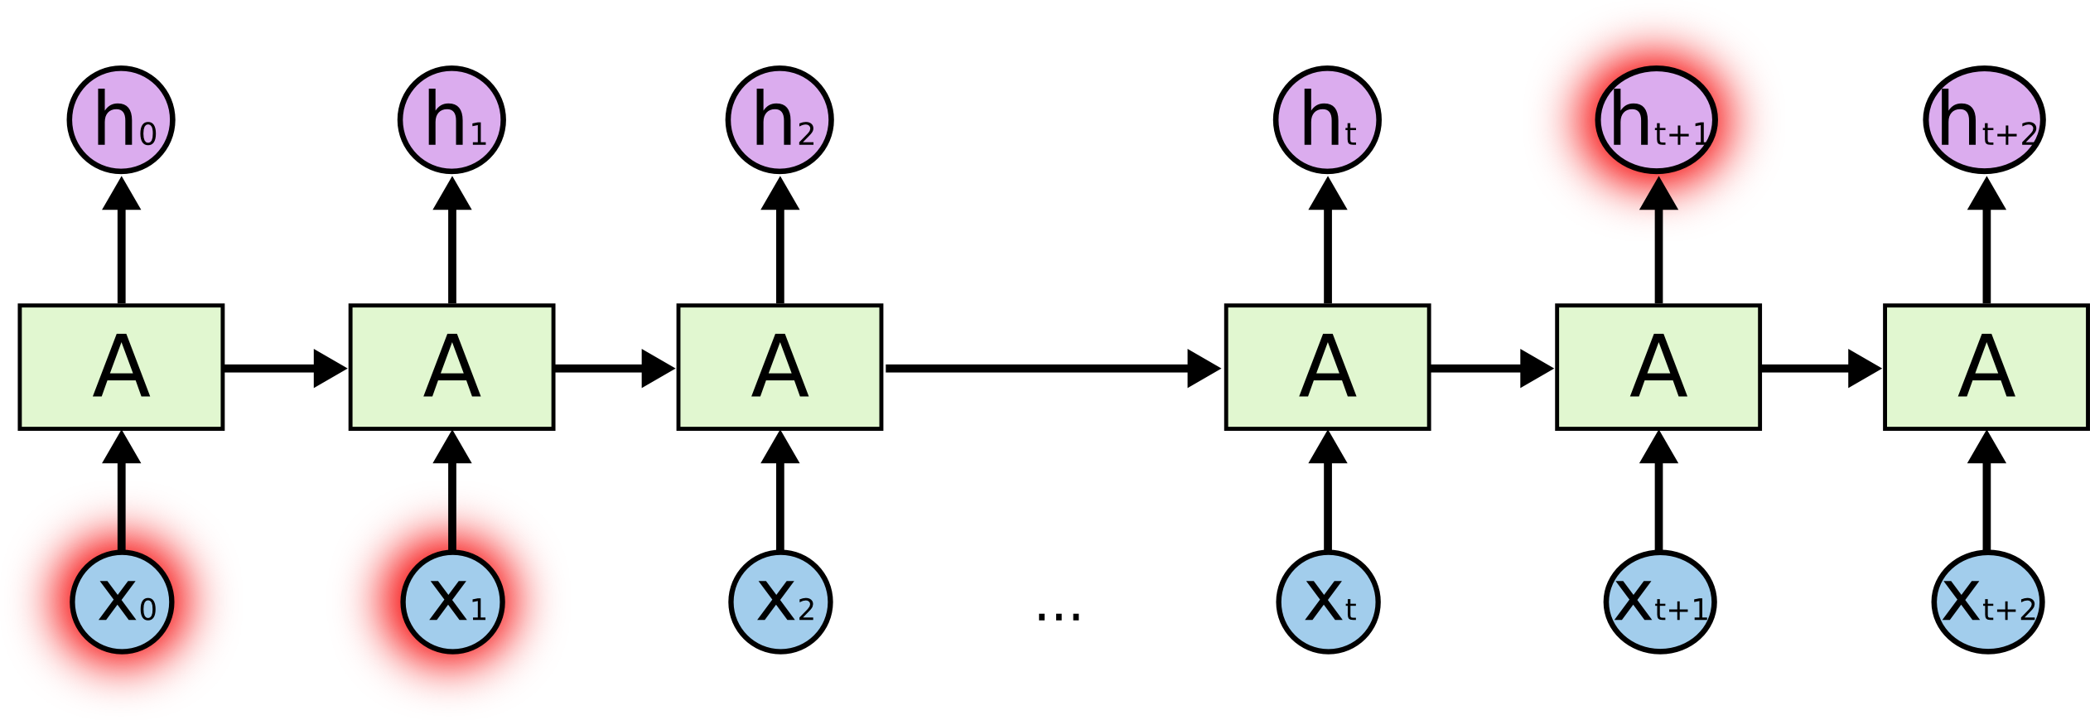
The Problem of Long-Term Dependencies
One of the appeals of RNNs is the idea that they might be able to connect previous information to the present task
When the gap between the relevant information and the place that it’s needed is small, RNNs can learn to use the past information.
But wait, not everything is smooth
It’s entirely possible for the gap between the relevant information and the point where the information is needed to become very large.
Unfortunately, as that gap grows, RNNs become unable to learn to connect the information.
Thankfully, LSTMs don’t have this problem!

Slide 5

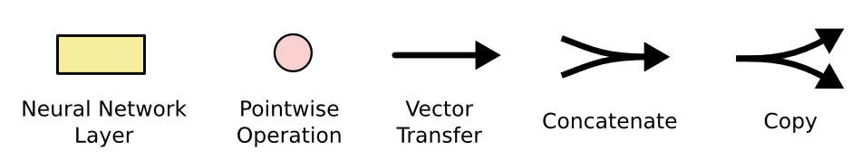
LSTM NETWORKS
Long Short-Term Memory networks – usually just called “LSTMs” – are a special kind of RNN.
LSTMs are explicitly designed to avoid the long-term dependency problem. Remembering information for long periods of time is practically their default behavior, not something they struggle to learn!
All recurrent neural networks have the form of a chain of repeating modules of neural network. LSTMs also have this chain like structure, but the repeating module has a different structure. Instead of having a single neural network layer, there are four, interacting in a very special way.
The repeating module in an LSTM contains four interacting layers.

Slide 6
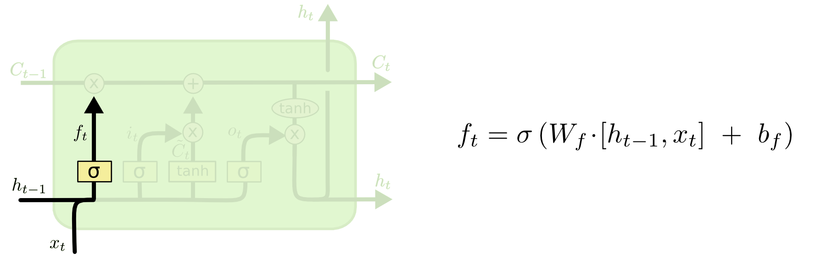
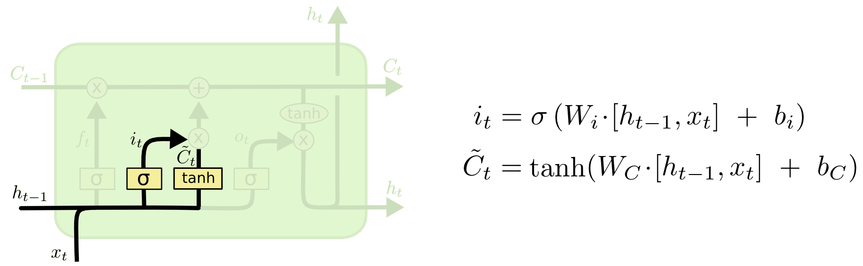
STEP – BY – STEP LSTM WALK THROUGH
STEP – 1 : THROW EVERYTHING THAT WE DON’T WANT
STEP – 2 : DECIDE WHAT NEW INFORMATION WE ARE GOING TO STORE

Slide 7
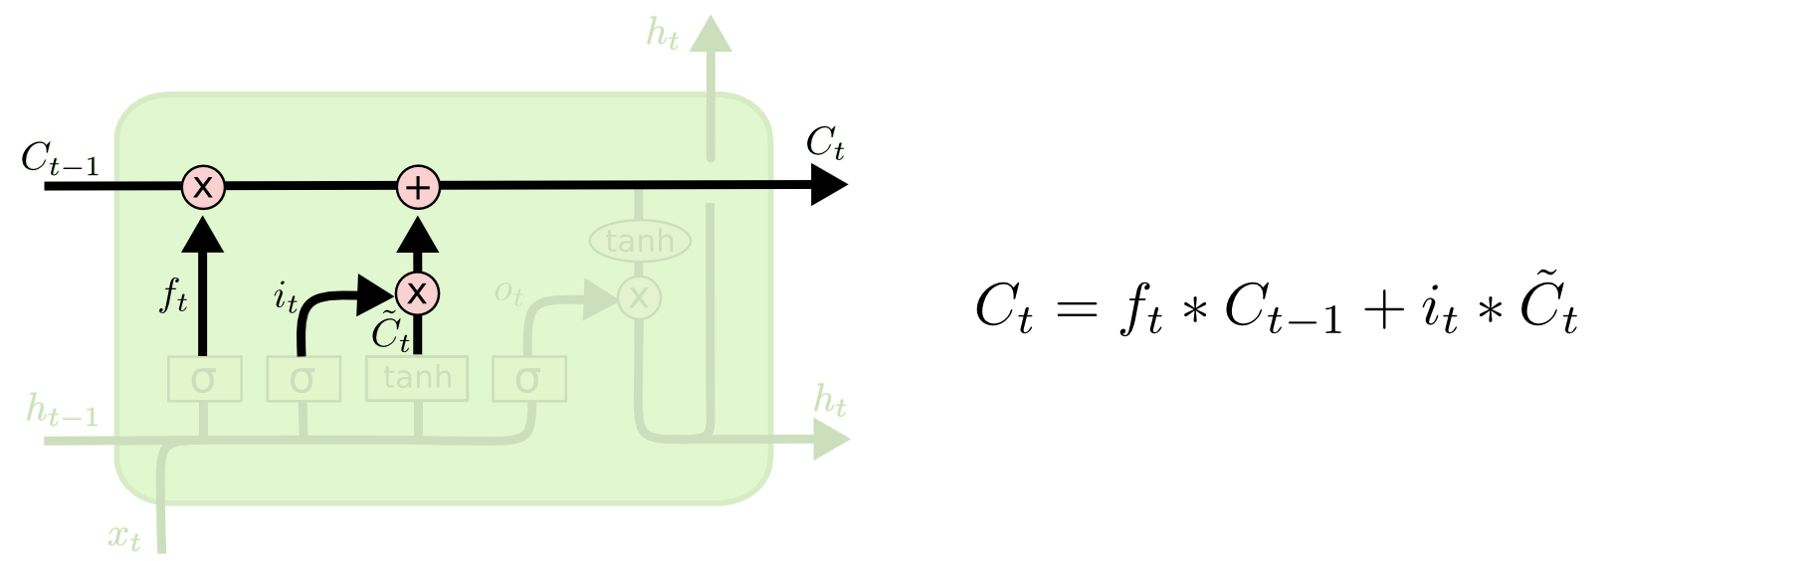
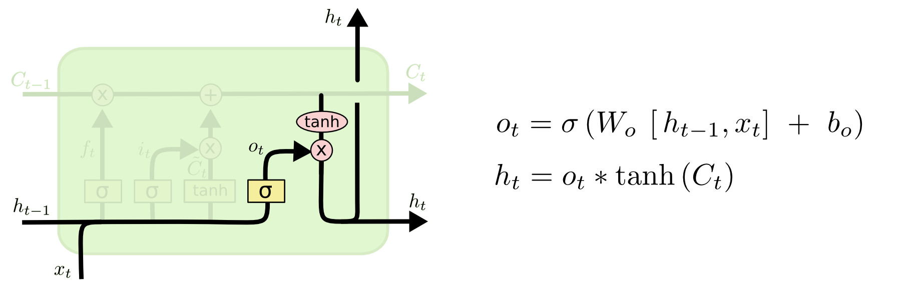
STEP – 3 : UPDATE THE OLD CELL STATE INTO NEW CELL STATE
STEP – 4 : FINALLY WE WILL BE DECIDING WHAT WE ARE GOING TO OUTPUT

